Slide 1

Therapeutic mechanisms and potency of VRC01 in HIV-infected patients
Rebecca Drachman
Notes:
Hi, I’m Rebecca Drachman and I’ve been working with the Schiffer group for the past 5 weeks. Thank you all so much for coming. I’d like to tell you about our work using math models to study VRC01, a broadly neutralizing antibody.

Slide 2




Acknowledgements
Pavitra Roychoudhury, PhD
Elizabeth Duke, MD
Josh Schiffer, MD, MSc
Daniel Reeves, PhD
Notes:
First, I would like to acknowledge some people who have contributed a lot to this project and have helped me along the way. Josh, Pavitra, Elizabeth, and Dan have all been instrumental to my progress and have helped me immensely. So, thank you so much to them.

Slide 3
Main points
In vitro measurements of the potency of VRC01 are likely overestimates of the in vivo potency
Neutralization, rather than ADCC, appears to be responsible for HIV viral suppression in patients
Long VRC01 half-life & either potent ADCC or potent neutralization is more critical than achieving both potent ADCC & potent neutralization
Notes:
By the end of this talk I want to have shown you these three main parts. 1: we have found that in vitro measurements for the potency of VRC01 are higher than the in vivo potency. 2: we believe that neutralization, rather than ADCC, is responsible for viral suppression when HIV infected patients are treated with VRC01. And 3: a long VRC01 half-life and either potent ADCC or potent neutralization is more important than achieving both potent ADCC and potent neutralization.

Slide 4
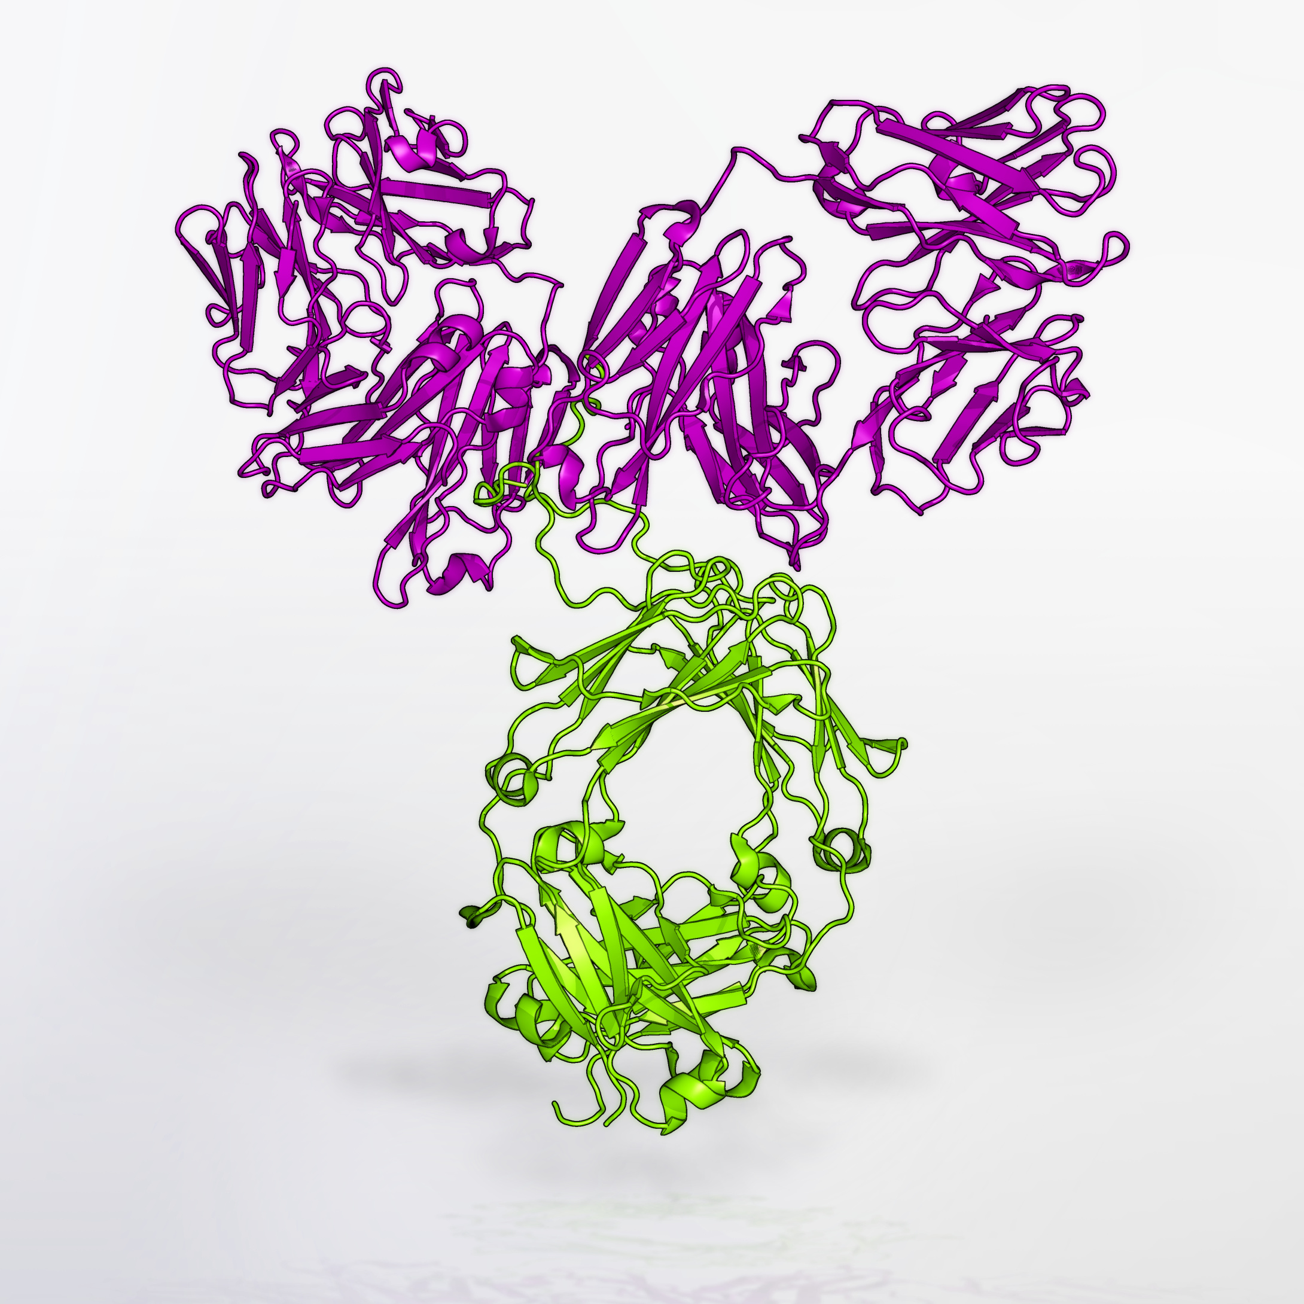
VRC01 = broadly neutralizing antibody
Identified in a chronically HIV-infected patient
Potent and broadly neutralizing
Developed by the Vaccine Research Center
https://www.niaid.nih.gov/news/newsreleases/2016/Pages/AMP-studies-launch.aspx
Notes:
VRC01 is a very exciting development in the HIV research field. It is an antibody that was first identified in a chronically HIV-infected patient and was found to be potent and broadly neutralizing. The Vaccine Research Center then worked to develop it and fine tune it.

Slide 5

http://www.hvtn.org/en/news/amp-press-release.html
Notes:
The AMP study, is a huge international clinical trial that is going test the use of VRC01 as prevention of HIV in high risk people. The study will enroll nearly 4,000 patients in the Americas and Southern Africa. One third of patients will receive regular high dose infusions of VRC01, another third will receive regular low dose infusions of VRC01, and the last third will be a control group.

Slide 6
Study question
Does VRC01 decrease HIV viremia in chronically infected, patients not on ART via neutralization or ADCC?
Notes:
As exciting as the AMP study is, much remains unknown about the interaction between VRC01 and HIV. We were curious about how VRC01 really works and about the mechanics of the antibody. While the AMP study is evaluating VRC01 as a prevention plan, we decided to examine a different scenario: which is treating HIV-infected patients with VRC01.

Slide 7
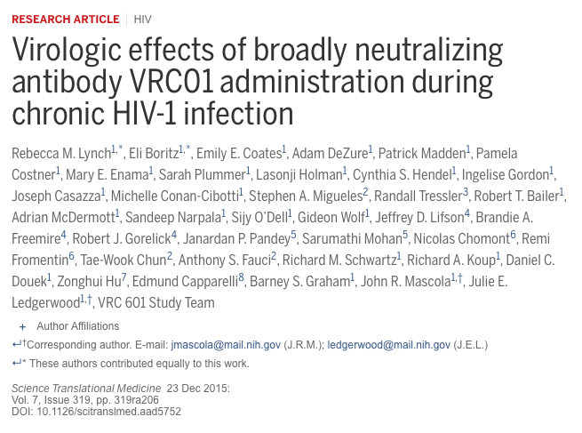
VRC01 as treatment
Notes:
Rebecca Lynch and many others at the Vaccine Research Center conducted a study in which they treated HIV infected patients with VRC01. This study provided the data that we needed to approach our study question. Of the participants in this study, 8 were chronically HIV infected patients without ART treatment.

Slide 8
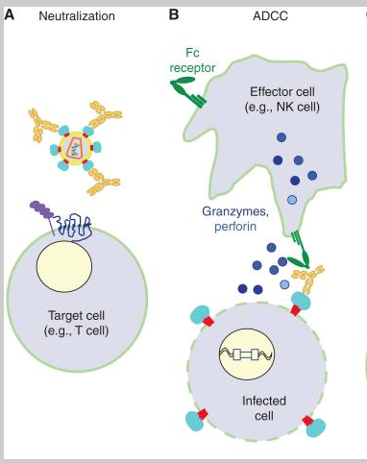
Antibody mechanisms
Overbaugh, Julie, and Lynn Morris. “The Antibody Response against HIV-1.” Cold Spring Harbor Perspectives in Medicine 2.1 (2012): a007039. PMC. Web. 2 Aug. 2016.
Notes:
Here’s a quick overview of the two mechanism in question when it comes to VRC01 interacting with HIV. Neutralization, on the left, happens when the antibody bind to free virus (specifically, the CD4 binding site on the gp120 envelope), and thus inhibits it from infecting target cells. ADCC, or antibody dependent cell-mediated cytotoxicity, is when the antibody binds to HIV infected cells and induces an cytolytic response in which effector cells come to kill the infected cell. I modeled the effects of these two mechanisms on HIV.

Slide 9
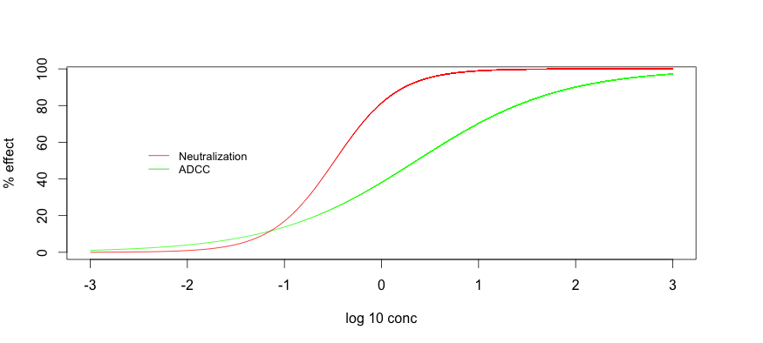
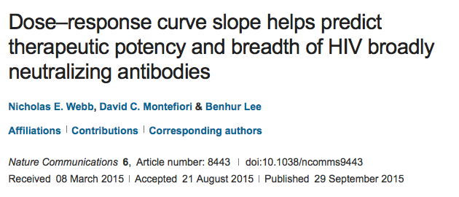
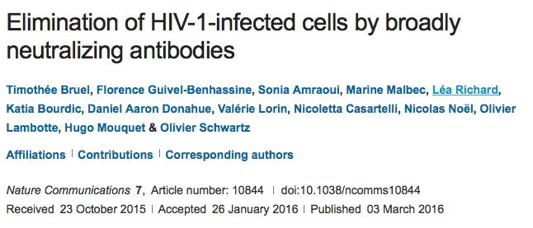
VRC01 potency
Neutralization
IC50 = 0.33 mcg/mL (Lynch)
Hill slope = 1.3 (Webb)
ADCC
IC50 = 2.3 mcg/mL (Bruel)
Hill slope = 0.58 (Bruel)
Notes:
There are two variables that determine a dose-response curve: the IC50 and the hill slope. The IC50 is the concentration of the antibody at which half of the maximum effect is achieved and the hill slope is the slope of the curve at the IC50.
Here are the in vitro values for VRC01. As you can see, VRC01 has both a lower IC50 for neutralization and a higher hill slope for neutralization, which corresponds to greater overall effect.
This graphic shows a dose response curve for VRC01, with both neutralization and ADCC, made using literature values. Because neutralization has a larger hill slope, you can increase concentration a little bit and see a large increase in neutralization effect. ADCC, however, has a lower hill slope, and thus you would have to increase concentration a lot in order to see an increase in effect.

Slide 10
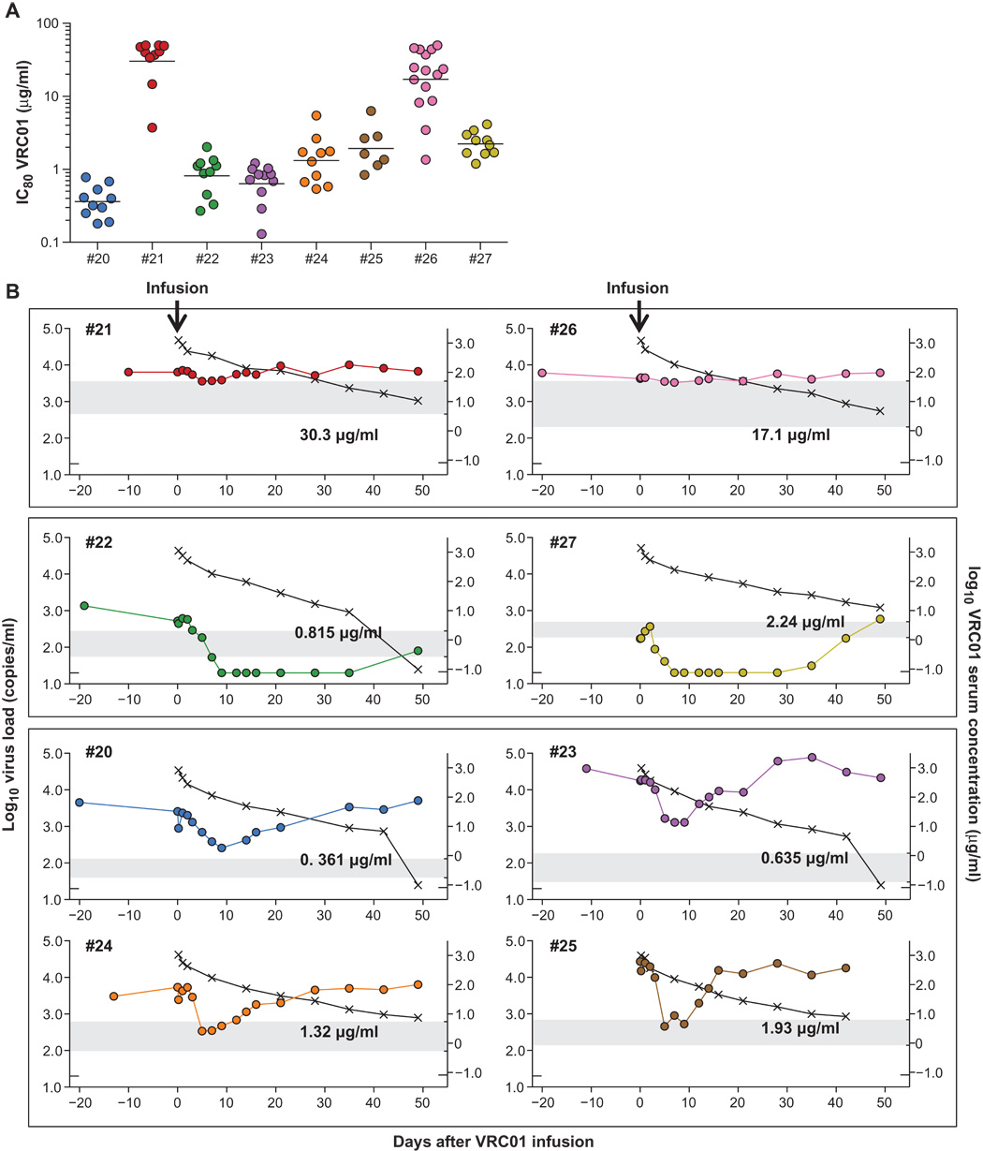
Lynch, Rebecca M. 23 Dec 2015. Virologic effects of broadly neutralizing antibody VRC01 administration during chronic HIV-1 infection. Science Translational Medicine. Vol. 7, Issue 319: pp. 319.
Notes:
This graphic comes from the Lynch study and shows each individual patient’s viral load over time (in colors) and antibody concentration over time (in black). Additionally, the gray bars show the range in vitro IC80 measurements (which is just the concentration of the antibody at which 80% of the maximum effect is achieved) and the average IC80 is labeled on each graph.
Patients #21 and 26 saw no change in viral load because they both had resistant virus. Accordingly, they both had very high IC80 values.
Patients #22 and 27, who had low initial viral loads, both experienced a viral load suppressed below detection for some time.
The bottom four patients experienced brief periods of viral suppression and then rebounded quickly.
This graph also informed our knowledge of the antibody’s kinetics: it appears to be a biphasic exponential decay.
The most important message of this data, however, has to do with the IC80’s. Every patient that had a rebound, excluding patient #22, had an antibody level well above the IC80 at the time of rebound. This very clearly means that those in vitro IC80 measurements do not correspond with the in vivo IC80’s. This discrepancy made as curious about the in vivo potency of VRC01 and how we could determine it.

Slide 11
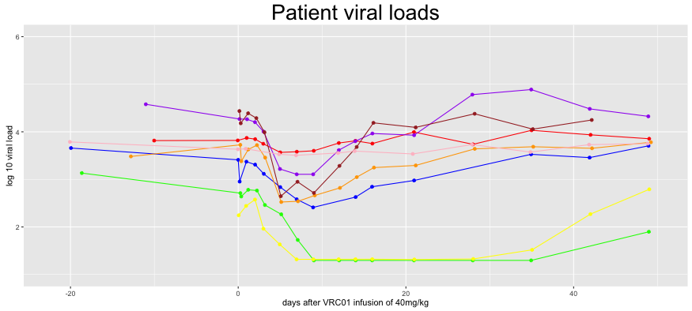
Differing pre & post VRC01 infusion viral dynamics amongst patients
Notes:
This graph shows a composite of the Lynch data. Three things that are interesting not are that: 1, the patients had a variety of different viral set points before treatment, 2, the patients had different levels and length of viral suppression, and, 3, the patients returned to their initial viral loads after treatment.

Slide 12
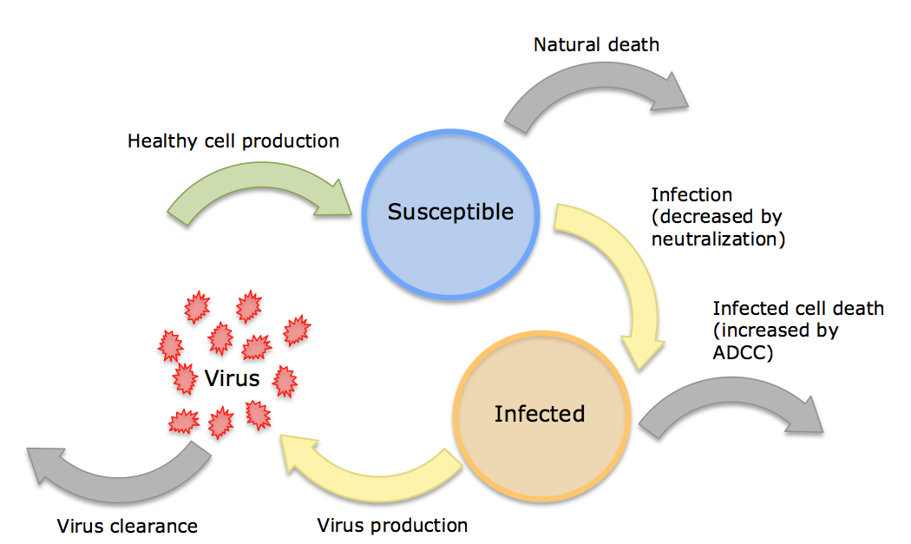
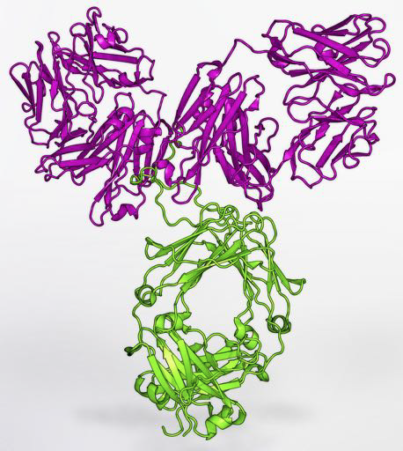
Model
Notes:
In order to answer the many questions we had after looking at the study data, we made a model. This is the outline of the model I have been using. There are three “compartments:” susceptible cells, infected cells, and free virus. All of the rates you see in this diagram were taken from the literature. As you can see, the neutralization decreases the infectivity (because it prevents viruses from infecting susceptible cells), and ADCC increases the death rate of infected cells (because the antibody binds to them and induces a cytolytic response). If you have any questions about the actual equations, I’d be happy to show you those at the end.

Slide 13
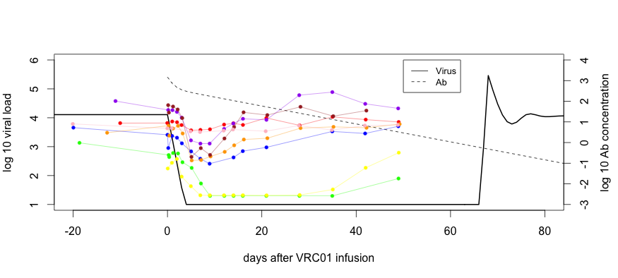
Simulations with in vitro IC50 and hill slope values overestimate potency & duration of VRC01 effect
Notes:
This graph shows the results of my simulation, in black, using literature values for VRC01 potency, as well as the patients’ viral loads in colors. The antibody concentration is shown by the dashed line.
As you can see, the model, which uses in vitro measurements, experiences more extreme and prolonged viral suppression than the patients did. This reinforces the idea that the in vitro measurements of potency are not representative of the in vivo potency of VRC01.

Slide 14
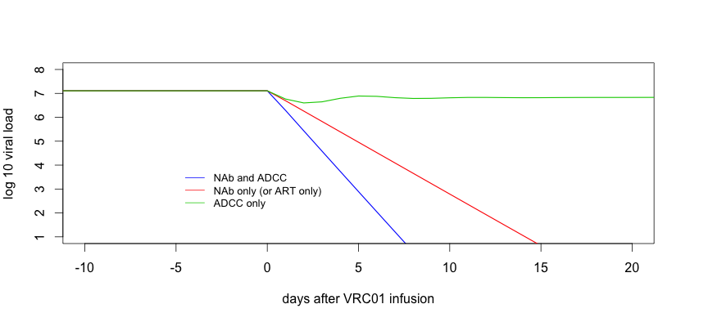
ADCC can theoretically be discriminated from neutralization based on viral decay kinetics
Notes:
This graph shows a simulation of viral load over time, assuming that neutralization and ADCC are both equally potent (I set the hill slopes and IC50’s to the same value). The red lines represent a simulation in which VRC01 is only capable of neutralization, the green line shows the antibody only capable of ADCC, and the blue line represents the antibody both neutralizing free virus AND killing infected cells. When the antibody is only employing ADCC, the viral load hardly changes at all, except for a small depression after infusion. The red and blue lines, however, both see suppression of viral loads to undetectable levels. What does differ between these two scenarios is that, when both ADCC and neutralization are present, the viral decay is steeper than when VRC01 is only neutralizing (which is essentially the same scenario as when patients are treated with ART). This discrepancy can help us identify whether ADCC is operational in our patient data.

Slide 15
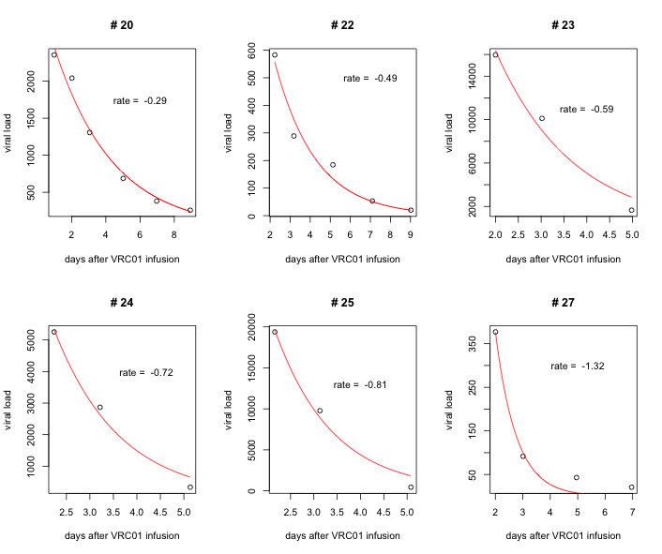
Viral decay rates favor no ADCC effect early after VRC01 infusion
Notes:
As we know, the slope of viral decay corresponds to the mechanisms at work. In the first phase of viral decay during ART, the rate of viral decay is equal to the death rate of infected cells (known to be 1), assuming that ART is 100% effective in neutralizing free virus. This scenario is the same as if VRC01 were only capable of neutralizing free virus. This point of reference can be used to infer what exactly VRC01 is doing in the 6 patients from this study that responded to the treatment. Here are the decay rates of the patients that responded to treatment, ranging from .29 to 1.32, with an average of .70. The fact that this number is not higher than 1, the natural death rate of infected cells, suggests that ADCC may not have as much of an effect, or as consistent of an effect, in these 6 patients. If ADCC were having a significant and consistent effect, we would expect the death rate of infected cells to be greater than 1 (as their death is accelerated by ADCC), thus resulting in a decay rate greater than 1.

Slide 16
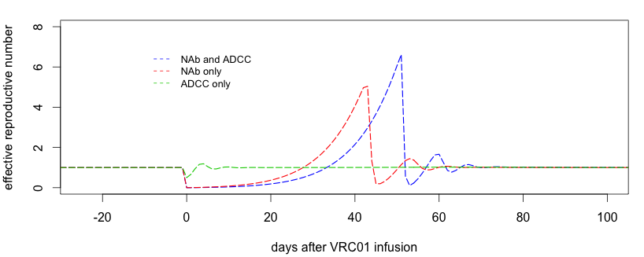
VRC01 half-life, rather than combined ADCC & neutralization, predicts time to viral rebound
R = 1
Notes:
Effective reproductive number, or R, is a measure of how many other cells each infected cell could potentially infect in its life time. This means that, if there is viral reactivation, when R is greater than 1 there will be a take off, when R is less than 1 there will be a blip, and when R equals 1 viral load will be stable. This graph shows effective reproductive number over time, with different combinations of antibody mechanisms at play. When ADCC is the only mechanism, R dips below 1 for a short period after infusion, but quickly returns to 1 (a steady viral load). Neutralization only, results in prolonged suppression with R below 1 and rebounds only slightly earlier than when ADCC and neutralization are both present. Because of this, the half life of the antibody appears to be controlling when R (and viral load) rebound, rather than the combinatory effect of both mechanisms.
R=1 line

Slide 17
Conclusion
In vitro values for VRC01 neutralization potency are overestimates
Preliminary results suggest that ADCC may not be operative when VRC01 is given therapeutically
Long VRC01 half-life & either potent ADCC or neutralization, is more critical than achieving both potent ADCC & potent neutralization
Notes:
Data from the study showing viral rebound before in vitro calculations of the IC80’s, as well as the discrepancy between the model (using in vitro potency values) and the patients’ results both suggest that the literature values for VRC01 potency are overestimates. The patients’ viral decay rates led us to believe that they were not consistently or significantly experiencing ADCC in their treatment. Finally, the modeled scenarios implied that having a long antibody half life and a single very potent mechanism is more important than having both potent ADCC and neutralization.

Slide 18
Limitations
This is a work in progress
Small sample size
Model currently ignores de novo development of viral escape mutations
No endogenous immune response in model
Notes:
There are different factors that are important to note when thinking about these results, however. First: this is very much still a work in progress. The sample size for the data I am using is relatively small, so it is therefore important to not extrapolate these findings or interpret this trend as a rule. There are also parts of the model that are not as biologically accurate as they could be: I have yet to incorporate resistance to virus or escape mutations, there is also no endogenous immune response, and the model for HIV, itself, is simplified.

Slide 19
What’s next?
Fit model to data to determine antibody parameters
Sensitivity analysis to identify the critical parameters for therapeutic efficacy
Develop stochastic model for HIV rebound
Find more data to incorporate
Notes:
This project has raised many questions about antibodies as prevention and/or treatment of HIV.
I am currently in the process of fitting my model to the patients’ data in order to determine the in vivo measurements of the antibody IC50 and hill slope for neutralization and ADCC.
Going forward we plan to conduct a sensitivity analysis in order to determine which property of the antibody is the most important to achieve prolonged viral suppression. This model is currently a deterministic model, meaning that there is no element of randomness—going forward, we plan to develop a stochastic model to better capture the variations in responses to treatment and virus itself. Additionally, my analysis incorporates only a small amount of data—we aim to gather more relevant data.

Slide 20

Thank you!
Notes:
Thank you all again for listening.

Slide 21
Questions?
Notes:
I would be happy to take any question or feedback, now.

Slide 22
Parameters
Parameter | Value | Source
Healthy CD4+ cell birth rate | 300 cells/mcl/day | Rutao Luo, Michael J. PLOS ONE. 2012.
Healthy CD4+ cell death rate | .02/day | Perelson, Alan S. Mathematical Biosciences. 1993.
Infected CD4+ cell death rate | 1/day | Markowitz, Martin. Journal of Virology. 2003.
Virus clearance rate | 23/day | Ramratnam, Bharat. The Lancet. 1999.
Infectivity | 10^-4 mcl/day/virus | Perelson, Alan S. Mathematical Biosciences. 1993.
Virus produced per infected cell per day | 10^3 virus/cell/day | Perelson, Alan S. Mathematical Biosciences. 1993.

Slide 23
Equations
dS/dT = α – δs*S – f_{u}*β*S*V
dI/dT = f_{u}*β*S*V – (δi +δc)*I
dV/dT = π*I – c*V

